Slide 1
Orleans ❤ Service Fabric
A mega-quick demonstration of aforementioned love.

Slide 2
Service Fabric: What is it?
A distributed systems platform
Offers:
Hosting
Service Discovery
Application Lifecycle Management
State Replication (the killer feature, IMO)
Also:
Virtual Actors inspired by Orleans (“Reliable Actors”)
Distributed Collections (“Reliable Services”)

Slide 3
If Service Fabric Offers Actors, Why Orleans?
Orleans has many more features
Orleans is far more mature
Orleans is evolving rapidly
Orleans is truly open source (Service Fabric is closed)
Orleans has a very strong community

Slide 4
What does Service Fabric Offer Orleans?
Application Lifecycle Management
A system for deploying & updating your Orleans silos & client apps
Deploy different versions of your app side-by-side on the same machines for testing, etc.
High-density hosting
Deploy many services to the same box
Caveat emptor: noisy neighbours. Service Fabric offers resource management/restrictions & load balancing.
Independence from Azure
You could use Service Fabric for all storage functionality used by Orleans

Slide 5

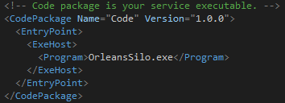
Deployment Model
Deploy Applications, which are made up of individual Services which are made up of Code, Config, & Data Packages
Typically: one app = one service = 1 code package & 1 config package
Application has a manifest describing
which services & versions are included
+ some config.
Services have a manifest describing which
packages & versions are included.

Slide 6
Demo
Hopefully the powers that be have accepted my sacrifice

Slide 7
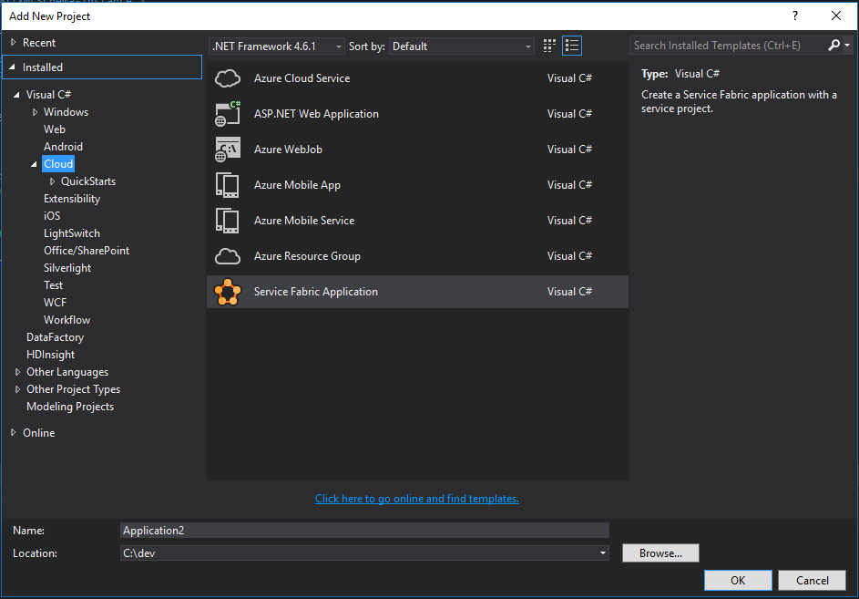

Slide 8
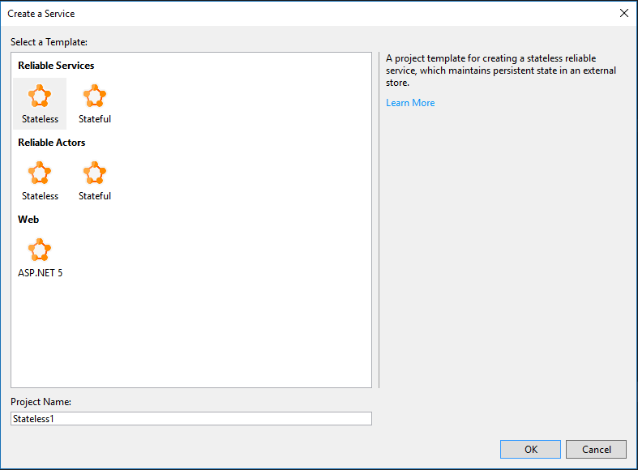

Slide 9
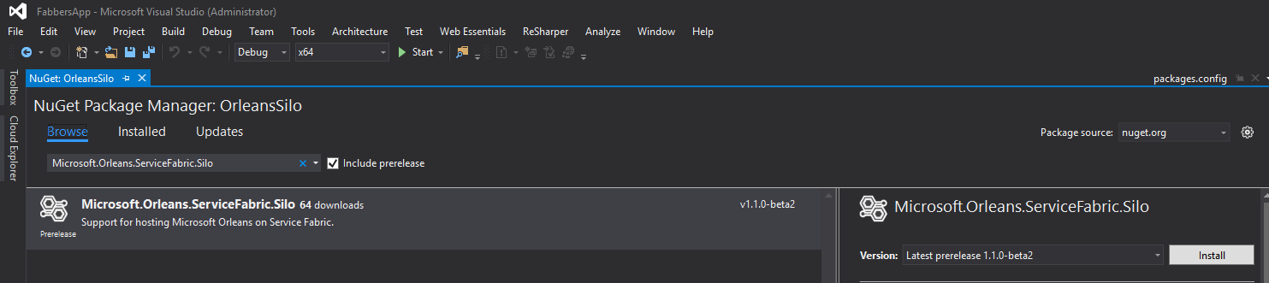
Service Fabric is prerelease, and therefore so it the interop package, so check this box.
Click this
Type this

